Slide 1
Implementation of competition
Jorik de Boer & Kees Wesselink
14-12-2016
Notes:
Names
We are Richel’s minions
Comparing to PBD
3 different Mechanistic individual based models

Slide 2
SES
Phenotypic ecological and male trait
Female preference -> male trait
Fitness = ecological trait (+ male trait)
Attractiveness = fem pref – male trait
(+ eco trait – eco trait)
Notes:
Model with sexual part
And ecological part

Slide 3
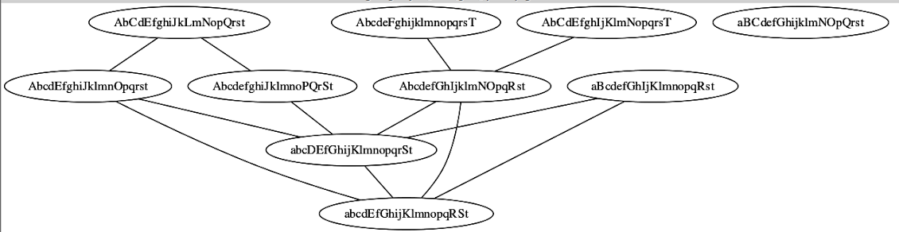
BDM
Genotype of uppercase & lowercase letters
Incompatible genotypes
Notes:
Genotype of even number of loci (letters)
Mutation, recombination
Parameters: population size, loci, generations, mutation rate
Mention Richel’s model

Slide 4
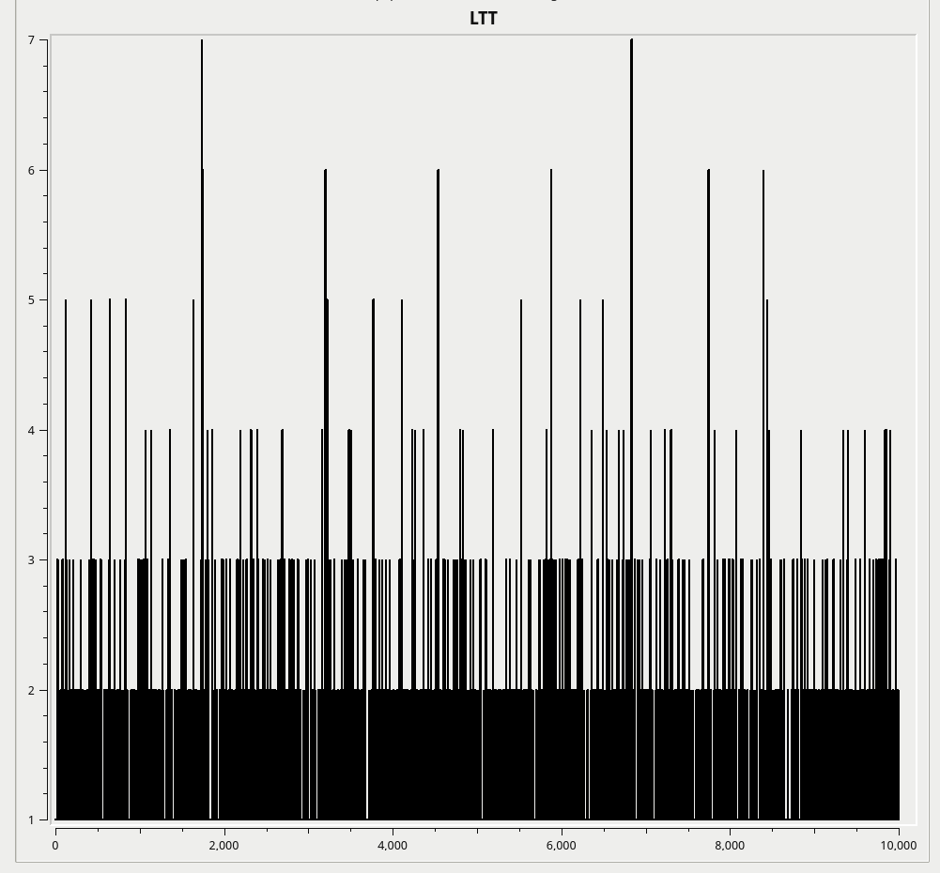
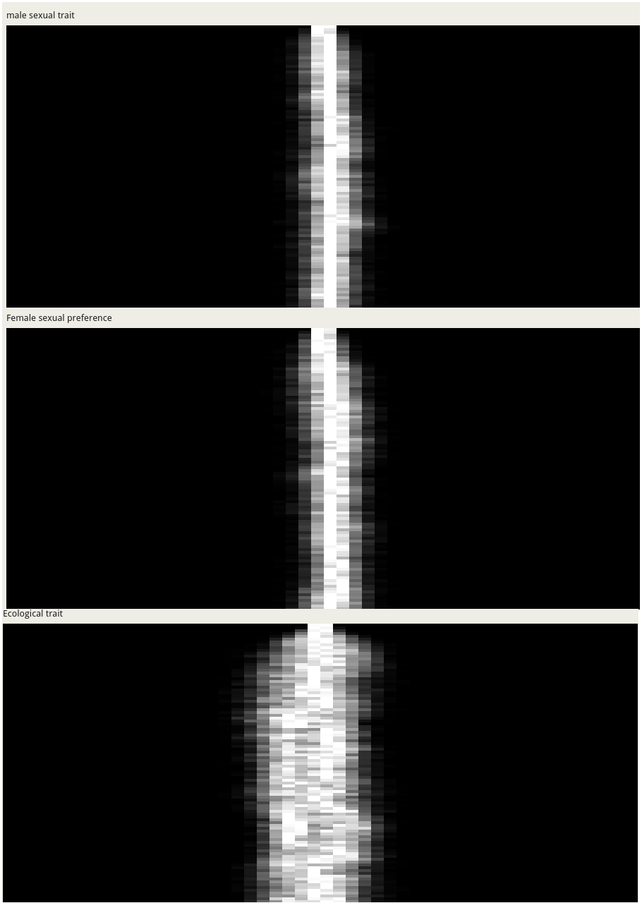
Problem (1)
BDM - Jorik
SES - Kees
Notes:
Explain axes
Rampal gave suggestion of bigger population sizes (1 million in this case)
Still no disruptive selection
Generation 10000
Mutation rate 0.2
Loci 16

Slide 5
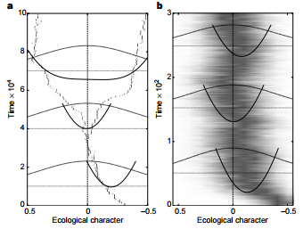
Problem (2)
X₀ = Evolutionary stable
OR
X₀ = Fitness minimum
Dieckmann, U. and Doebeli, M. (1999) “On the origin of species by sympatric speciation”
Notes:
First maximal carrying capacity
When X₀ is evolutionary stable there will be no branching thus no disruptive selection according to Dieckmann (figure B / 1)
Evolution comes to halt
When X₀ becomes a fitness minimum there will be branching and thus disruptive selection “ “ (figure A /2 )
So we want to implement a fitness minimum at X0 in our models

Slide 6
Possible solution
Implement competition
Now: Absolute chance of surviving
SES: based on ecological trait, male trait & population
BDM: based on genetic trait & population
Idea: Relative chance of surviving
1 2 3 4 5 6 7 8 9
0.5
0.9
0.1
0.2
0.3
0.8
0.2
0.6
Notes:
To get fitness minimum we want to implement competition
Right now there is competition but it’s just implemented as an absolute chance of surviving
Based on either ecological trait, male trait and the rest of the population (competition)
OR based on genetic trait (number of uppercase letters) and the rest of the population (competition)
We thought to change it to relative chance to make competition not so extreme (too strong or too weak)
Everytime the model picks an individual to survive, so it will always pick an individual that survives in 1 step.
Explain example

Slide 7
Other suggestions?
To get:
Disruptive selection
Fitness minimum at X₀
(Relative) chance of surviving
Notes:
To summarize: we want to get disruptive selection in our models
Our idea is to achieve this with the implementation of a fitness minimum at X₀ by making the chance of surviving a relative value
Maybe you have other suggestions to achieve these goals by the implementation of some kind of competition

